Slide 1
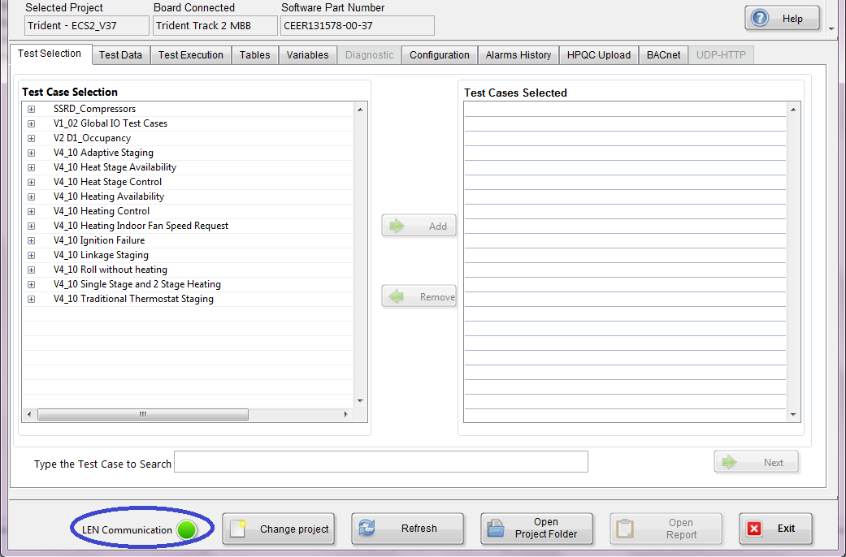
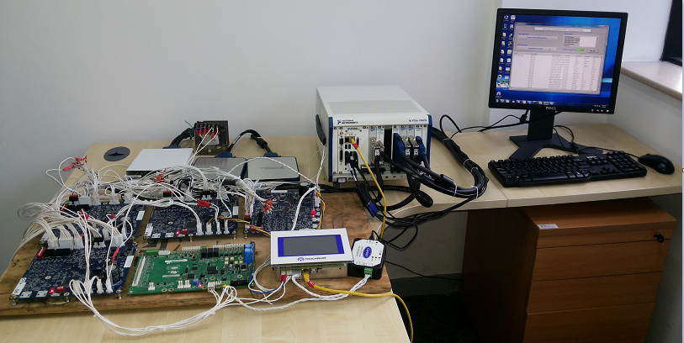
LabVIEW based Test Simulator
Scope
Test Simulator to aid in regression testing of the Control Boards of various Chillers
Hardware setup to simulate various electrical sensors
Interface custom or proprietary tools to the simulation environment.
Solution
LabVIEW based Simulator is a customized Automated Test Execution Tool
The Simulator shall load the Test Cases provided as excel templates or test step and execute the Test Cases
The Simulator shall allow the electrical components of a Heating Ventilation and Air Conditioning (HVAC) system to be tested in a laboratory environment
Proprietary Protocols, NI, Pickering and Advantech drivers are integrated to Smart Simulator
Environment
Challenges
LabVIEW
Microsoft Excel
Visual Studio MS Test Agent
HPALMQC, Tortoise SVN
Custom protocol implementation in LabVIEW
Plug and Play harness to test various control boards
Business Benefits
Virtual Testing allows the user to test the application developed with out the actual chiller
Reduction in cost by ~1600USD per regression testing

